Slide 1
Software Requirement Engineering
CSE-305
Dr Ghulam Rasool

Slide 2
Requirements Elicitation
Elicit means to gather, acquire, extract, obtain, or discover etc.
Requirements elicitation means gathering requirements or discovering requirements
Elicitation is the process of discovering the requirements for a system by communication with customers, system users and others who have a stake in the system development.
Elicitation is concerned with learning and understanding of the needs of users and project sponsors with the ultimate aim of communicating those needs to the system developers
Activities involved in discovering the requirements for the system require
Knowledge Acquisition
Reading
Interviewing
Listening
Asking
Observing etc.

Slide 3
Requirements Elicitation
Requirement elicitation is the most difficult, most critical, most error prone and communicative intensive activity. It focuses on following aspects:
Elicitation objectives
Exploring use cases
Validating market data
Elicitation strategies
Some combination of surveys, workshops, customer visits, individual interviews, and other techniques

Slide 4
Requirements Elicitation
Products of elicitation efforts
A list of use cases, a detailed SRS, an analysis of survey results, or performance and quality attribute specifications
Resource and time constraints
Identify both development and customer participants in the various elicitation activities, along with estimates of the effort and calendar time required
Elicitation risks
identify factors that could impede your ability to complete the elicitation activities as intended, estimate the severity of each risk

Slide 5
Sources for Requirement Elicitation
Interviews and discussions with potential users
Documents that describe current or competing products
System requirements specifications
Problem reports and enhancement requests for a current system
Marketing surveys and user questionnaires
Observing users at work
Events and responses etc.

Slide 6
Requirement Elicitation Activities
Define requirement development process
Define vision and scope
Identify user classes
Establish focus groups
Identify use cases
Identify system events and responses
Hold facilitated workshops
Examine problem reports
Reuse requirements

Slide 7
Classifying Users Input for Elicitation
Business requirements
Use cases or scenarios
Business rules
Functional requirements
Quality attributes
External interface requirements
Data definitions
Constraints
Solution ideas

Slide 8
Requirement Elicitation Problems
Requirements elicitation is a complex and imprecise process that varies greatly for different projects
Understanding large and complex system requirements is difficult
Study by Beichter indicate that 70% of the systems errors are due to inadequate system specification
Many technical problems are related to this process
Scope problems
Problems related to the process itself
Many problems pertaining to human nature

Slide 9
Requirement Elicitation Problems
Problems of Scope
Boundary of system is not well defined
Problems of understanding
Users have incomplete understanding of their needs; analysts have poor knowledge of the problem domain
Conflicting requirements
Difficult to express
A Savant Institute study found that “56% of errors in installed systems were due to poor communication between user and analyst in defining requirements
Problems of volatility
Requirements evolve over time
Elicitation process should not be executed only once

Slide 10
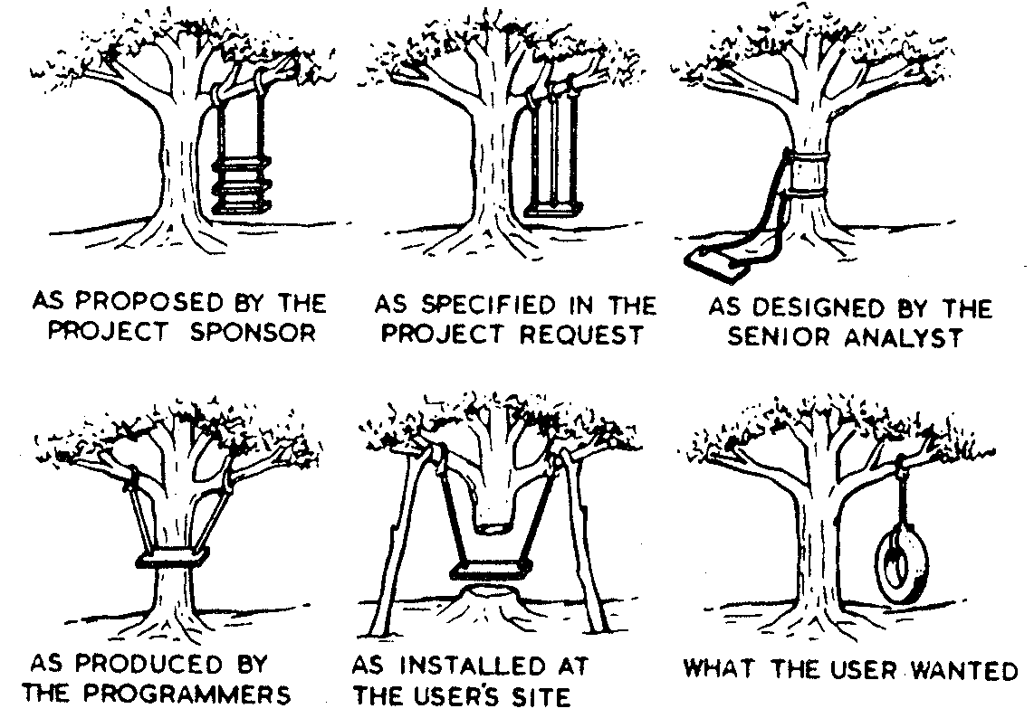
Elicitation Problems

Slide 11
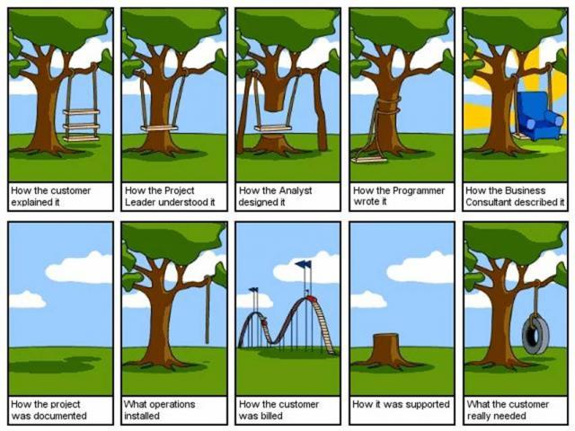
Elicitation Problems

Slide 12
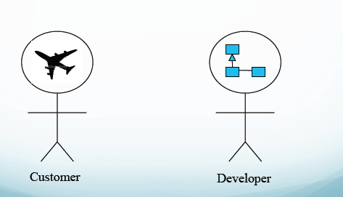
Customer and Developer Gap

Slide 13
Requirements Elicitation Guidelines
Assess the business and technical feasibility for the proposed system
Identify the people who will help specify requirements and understand their organizational bias
Define the technical environment
Identify “domain constraints” that limit the functionality or performance of the system
Define one or more requirements elicitation methods (interviews, focus groups, team meetings)
Identify ambiguous requirements as candidates for prototyping
Create usage scenarios to help customers/users better identify requirements

Slide 14
Components of Requirements Elicitation
Application
Domain
Problem to be
Solved
Stakeholder
Needs and
Constraints
Business
Context

Slide 15
Dimensions to Requirements Elicitation
Application domain understanding
Problem understanding
Business understanding
Understanding the needs and constraints of system stakeholders
Application domain understanding
Knowledge of the general area where the system is applied
Problem understanding
The details of the specific customer problem where the system will be applied must be understood

Slide 16
Dimensions to Requirements Elicitation
Business understanding
Understand how systems interact and contribute to overall business goals
Understanding the needs and constraints of system stakeholders
Understand, in detail, the specific needs of people who require system support in their work

Slide 17
A General Requirements Elicitation Process
Establish
Objectives
Understand
Background
Organize
Knowledge
Collect
Requirements
Business
goals
Organizational
structure
Stakeholder
identification
Stakeholder
requirements
Problem to
be solved
Application
domain
Goal
prioritization
Domain
requirements
Domain
knowledge
filtering
System
constraints
Existing
systems
Organizational
requirements

Slide 18
Requirements Elicitation Process
The activities in process are usually mixed up with each other
The output from the requirements elicitation process should be a draft document which describes the system requirements, which is then analyzed to discover problems and conflicts in the requirements definition
This process is followed by the requirements analysis process.

Slide 19
Specific Elicitation Techniques
Interviews
Questionnaires
Requirements elicitation workshops
Scenarios
Written materials
Observations and social analysis
Requirements reuse
Prototyping etc.
Knowledge Elicitation

Slide 20
Elicitation Techniques
Selection of technique is dependent upon the particular context
Elicitation technique may be selected because of:
it is the only one that the analyst knows
it is the analyst’s favorite
it is the one prescribed by a specific methodology that is being followed by the system development
it is governed solely by the intuition of the analyst to be effective in current context

Slide 21
Interviews
The requirements engineer or analyst discusses the system with different stakeholders and builds up an understanding of their requirements
Planning is very important before going for conducting interview
There are two types of interviews
Closed Interviews
Open Interviews

Slide 22
Interviewing Essentials
Interview must be planned and scheduled
Select right stakeholders for interview
Be patience during interview
Interviews are less effective for understanding the application domain and the organizational issues due to terminology and political factors
Stakeholders must be given a starting point for discussion. This can be a question, a requirements proposal or an existing system
Interviewers must be aware of organizational politics. many real requirements may not be discussed because of their political implications

Slide 23
Interviews
Interviews have advantages and disadvantages
Not only what is said but also how it is said
Interviews provide flexibility to interviewer and interviewee
May ask combination of open ended and close ended questions
Costly and time consuming
Problem of biasness
Limited sample size

Slide 24
Questionarries
Questionarries are used when we want to gather requirements from peoples who are far away and large in number
Format of questionarrie should be user friendly and comprehensible
Avoid open ended and ambiguous questions in questionnaire
Ask short, precise, rating scale, ranking scale , interactive type of questions
Success depends on the return rate and honesty of respondent
Use double envelope method

Slide 25
Questionnaire
Questionnaire has advantage and disadvantages
Can quickly collect info from large numbers of people
Inexpensive and scalable
No pressure on respondent
Reliability of results
Respondent anonymity
Interpretation issue
Dishonest answers
Low return rate etc.

Slide 26
Questionnaire Structure
What
Usually leads to facts
What is problem of client
How
Usually leads to a discussion of process, not structure
Why
Usually leads to deeper motivations, information on structure
When
When does the problem occur
Could
Maximally open, might lead to no data

Slide 27
Elicitation Workshops
Requirement analyst frequently facilitates elicitation workshops. They are organized for eliciting requirements from selected stakeholders. The following guidelines are followed during elicitation workshops.
Set the ground rules
Stay in scope
Setting parking lots for latter discussions
Time box discussions
Keep team small and select appropriate members
Keep everyone engaged

Slide 28
Workshop Agenda
Set an agenda before the workshop and publish it along with the other pre-workshop documentation.
Balance is the key, try to stay on the agenda, but do not strictly obey it, especially if good discussion is going on
Allow for human behavior, and have fun with it.
Requirements are discussed and understood
Time for coordination to conduct several workshops
In some cases, representatives cannot make decisions.

Slide 29
Written materials
Documentation of system
Manuals
Business plans
Market studies
Maintenance reports
Error reports etc.

Slide 30
Scenarios
Scenarios are used when users feel difficulty to express their needs but they are capable to explain what they do and what are their problems
Scenarios are stories which explain how a system might be used. They include
A description of the system state before entering the scenario
The normal flow of events in the scenario
Exceptions to the normal flow of events
Information about concurrent activities
A description of the system state at the end of the scenario
Scenarios are examples of interaction sessions which describe how a user interacts with a system
They are applied at beginning of project

Slide 31
Brainstorming
Brainstorming involves both idea generation and idea reduction
Stakeholders come up with creative ideas or new approaches to a problem
The most creative, innovative ideas often result from combining, seemingly unrelated ideas
Generate as many ideas as possible, combine ideas, reduce ideas and prioritize ideas
Various voting techniques may be used to prioritize the ideas created

Slide 32
Observation and Social Analysis
People often find it hard to describe what they do because it is so natural to them. Sometimes, the best way to understand it is to observe them at work
Ethnography is a technique from the social sciences which has proved to be valuable in understanding actual work processes
Actual work processes often differ from formal, prescribed processes
An ethnographer spends an extended time observing people at work and building up a picture of how work is done
User may change their way of working

Slide 33
Requirements Reuse
Reuse involves taking the requirements which have been developed for one system and using them in a different system
Requirements reuse saves time and effort as reused requirements have already been analyzed and validated in other systems
Studies have shown that similar systems can re-use up to 80% of the requirements
Currently, requirements reuse is an informal process but more systematic reuse could lead to larger cost savings
Reuse reduces risk. Reused requirements have a better chance of being understood by all the stakeholders.
Requirements reuse may lead to additional reuse in other lifecycle activities.

Slide 34
Prototyping
A prototype is an initial version of a system which may be used for experimentation
Prototype may be a quick rough version of the system
Prototypes are valuable for requirements elicitation because users can experiment with the system and point out its strengths and weaknesses. They have something concrete to criticize

Slide 35
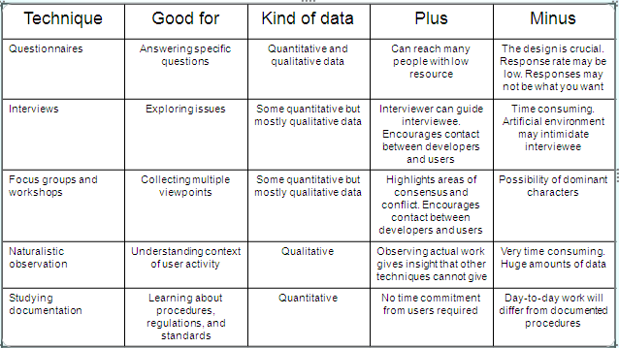
Comparison of selected Elicitation Techniques
[, Rogers, and Sharp “Interaction Design: Beyond human-computer interaction”, p1] Preece214

Slide 36
Finding Missing requirements
Decompose high level requirements into details
Check each user class represents input
Represents requirements in multiple ways
Check boundary value analysis
Use decision tables and trees instead of boolean logic

Slide 37
Research Directions for Elicitation
Reduce the gap between theory and practice, and experts and novices
Increase the awareness and education of analyst and stakeholders
Investigate ways of collecting and reusing knowledge about requirements elicitation
Develop guidelines for technique selection and managing the impact of the factors on the process
Integration and use of new technologies and tools
Explore how requirements elicitation activities relate to new and developing SE fields such as web-based, agent-based, agile, etc.

Slide 38
Papers
A New Approach for Software Requirements Elicitation
Requirements Elicitation Case Studies Using IBIS, JAD, and ARM
Requirements Elicitation – What’s Missing?
Requirements Elicitation and Elicitation Technique Selection: A Model for Two Knowledge-Intensive Software Development Processes
A Survey on Requirements Elicitation by Martin Fehrenbach
Techniques for Requirements Elicitation” by Joseph A. Goguen
Requirements Elicitation and Elicitation Technique Selection: A Model for Two Knowledge-Intensive Software Development Processes

